Slide 1

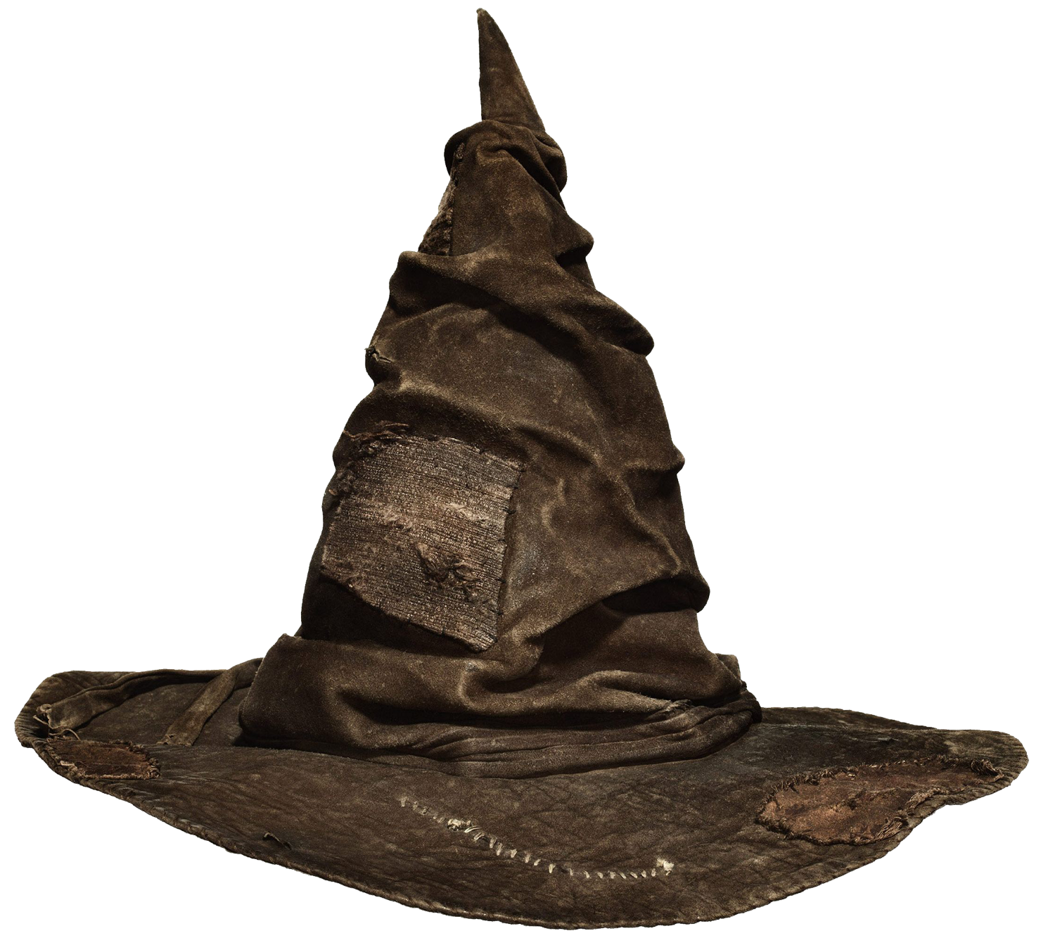
Machine Learning

Slide 2












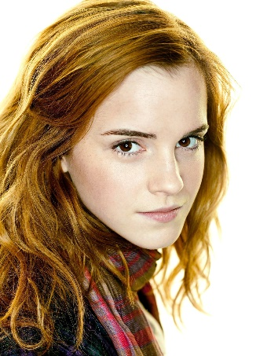
a.k.a. Train
Classify
Notes:
I learn from previous students so I can sort future students
What I learn is what distinguishes each house

Slide 3


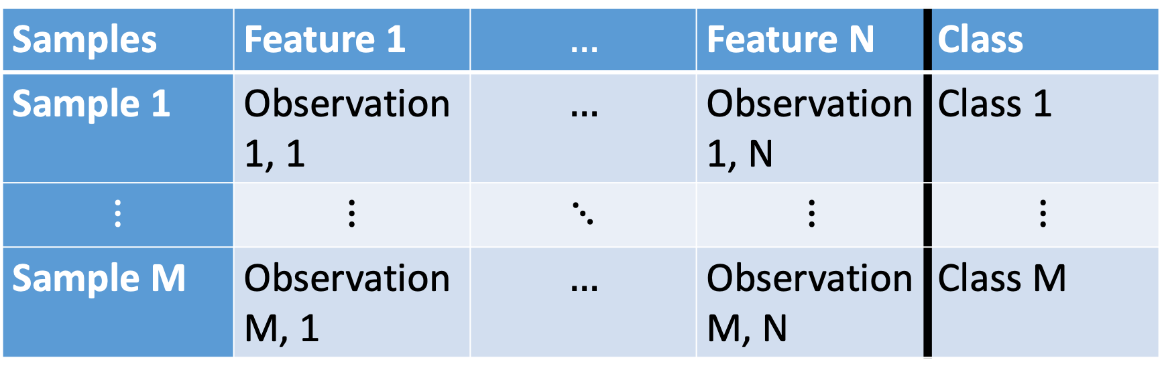
Data
Samples | Feature 1 | $$…$$ | Feature N | Class
Sample 1 | Observation 1, 1 | $$…$$ | Observation 1, N | Class 1
$$⋮$$ | $$⋮$$ | $$⋱$$ | $$⋮$$ | $$⋮$$
Sample M | Observation M, 1 | $$…$$ | Observation M, N | Class M
Notes:
SUPERVISED: We start off by knowing examples of what students from each house looks like

Slide 4

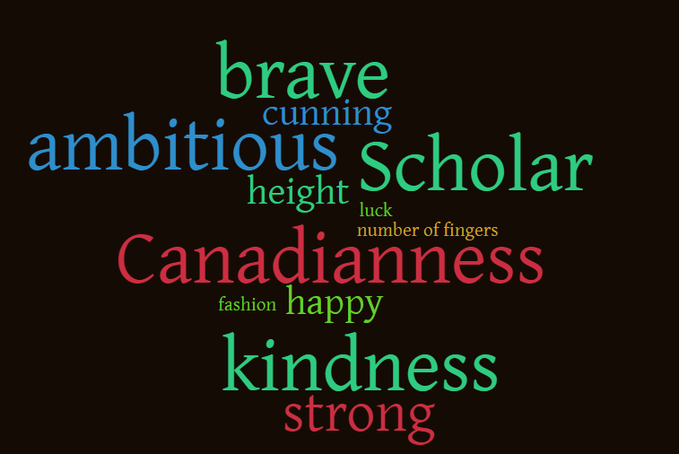
Features
Notes:
I gathered some data from 80 previous students to learn from
Some of them help distinguish classes, others not so much

Slide 5
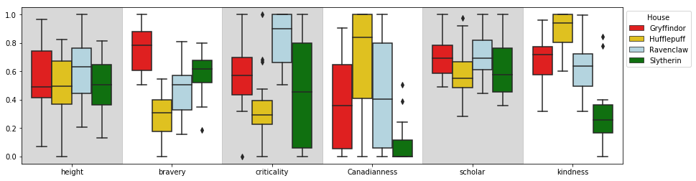
Features from 80 Hogwarts students
Notes:
We can start to see what defines each house
But this does not capture the INTERACTION between terms
A Gryffindor has a characteristic amount of bravery, criticality, etc.!
Let’s look at interactions

Slide 6
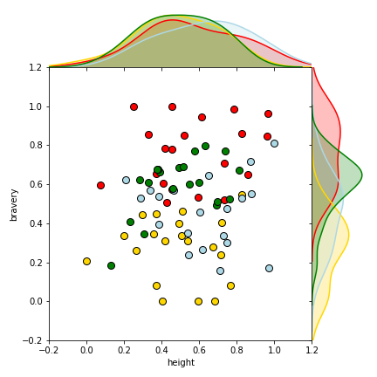
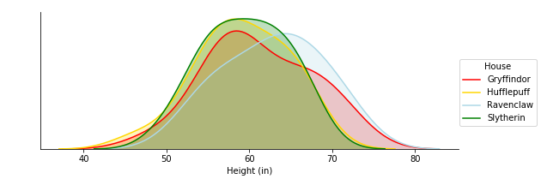
Height does not separate Houses
Interaction between bravery and height is dominated by effects of bravery
Notes:
Height is super easy to measure!
It does not separate clearly by house :/

Slide 7
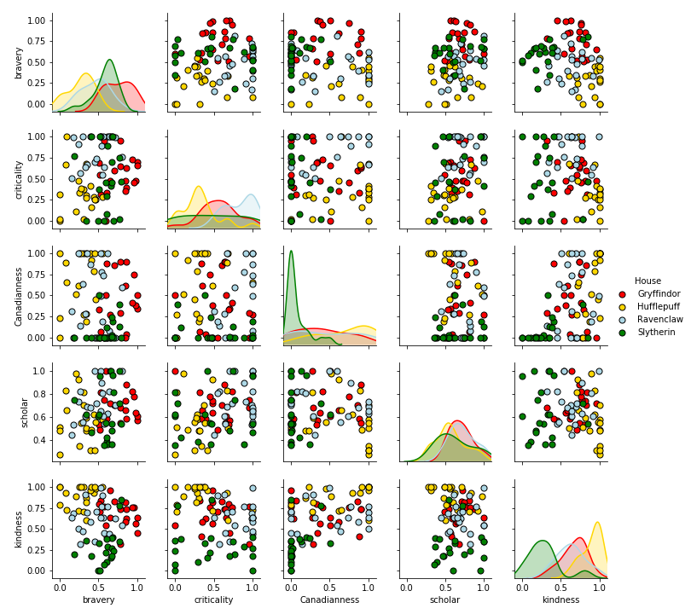
More pairwise comparisons of interactions!
Let’s not draw more lines though…

Slide 8
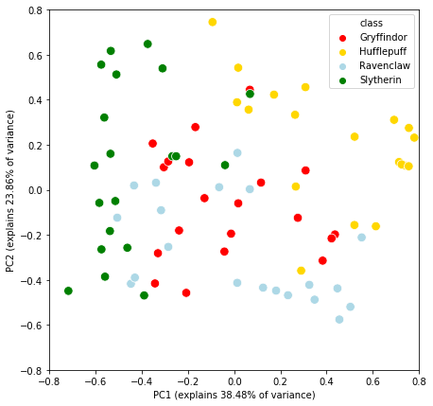
You mere muggles can only view things in up to two dimensions
Notes:
PCA is data scaled by the first two eigenvectors of the covariance matrix, duh
More simply, it is a projection of our 6 dimensional data into 2d space that preserves the variance between samples

Slide 9
Neural networks – visual system analogy
Hidden layer
Features
Input layer
Output layer
Photoreceptor
Photoreceptor
Visual cortext
Learn weighted mixtures of contributions of features (thickness of line=weight)
Notes:
Based on how the brain abstracts information from signals
Number of neurons is arbitrary
Hidden layers are abstracted from input layers
Weights are learned to understand how much each feature contributes to the next
SUPERVISED: Starts off knowing the difference between classes and then learns what features separates them
Guesses combinations of features
Narrows in on combinations that best separate

Slide 10


Neural Network on HP
Hidden layer
Features
Input layer
Hero
Output layer
Intellect
Dare-devil

Slide 11
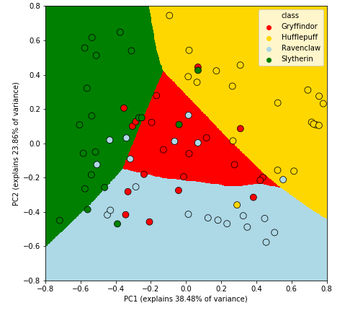
Decision Boundary – What we learned

Slide 12

Code availability
github.com/michaelsilverstein/TheSortingHat/
I made an interactive notebook for you to try yourself!

